Slide 1
Practical Considerations

Slide 2
Recommended design Process
A good deep learning practitioner needs to know how to choose an algorithm for a particular application and how to monitor and respond to feedback obtained from experiments in order to improve a machine learning system
Being a machine learning expert is not all about knowing a wide variety of algorithms and being good at math
In practice, one can usually do much better with a correct application of a commonplace algorithm than by sloppily applying an obscure algorithm.
Recommended design process for a deep learning model:
Determine your goal
What is the input to the system?
What is the output of the system?
How do you evaluate your system? What level of performance are you shooting for?
Establish an end to end system
Get up and running ASAP by building a simple system ( no need to be perfect at this stage)
Use an existing system for similar goal as a baseline
Determine the bottleneck in the performance
Overfitting? Underfitting? Bugs in the software? Bad/too small dataset?
Repeatedly make incremental changes based on finding
Adjust the hyperparameters. Do not make big changes unless the system is just too bad

Slide 3
Determine your goal

Slide 4
Determine your goal
First step in determining your goal is to decide which error metric you should use.
You should also have an idea of what level of performance you desire
Keep in mind that for most applications it is impossible to achieve absolute zero error, this is because:
The input features may not contain complete information regarding the output variable
We have a finite amount of training data
How do we know the level of performance we should be shooting for?
In academic world, we have some estimate of the error rate that is attainable based on the previous published works
In real-world setting, we have some idea of the error rate that is necessary for an application to be safe, cost-eﬀective, or appealing to consumer

Slide 5
Performance Metric
Another important consideration is what metric to use to evaluate the performance of our model?
For a regression problem, typical performance metrics are Root Mean Squared Error (RMSE), Mean Absolute Error (MAE), or Mean Absolute Percentage Error ( discussed in module2, Intro to feedforward neural networks lecture)
For a classification problem, a rudimentary measure is accuracy which measures the proportion of the examples that are correctly classified.
Depending on the need of the application, for many classification problems we might need a more advanced performance metric.
For instance consider an application where one type of error is much more costly than the other. An example of such application would be spam email detection where the cost of incorrectly classifying a legitimate email as spam is much more than classifying a spam as legitimate. For such applications, we might wish to measure some form of total cost where the cost of blocking a legit email has more weight than the cost of allowing spam messages.
As another example where accuracy is not a sufficient metric, consider the problem of detecting rare event ( for instance detecting fraudulent credit transactions). Suppose that one out of every 100K transactions is fraudulent. In this case a naïve classifier that classifies everything as fraudulent will have an accuracy of 99.999%.. For this kind of application it might be more appropriate to instead measure precision ( what percentage of transactions detected by the classifier were actually fraudulent ) and recall ( what percentage of the fraudulent transaction were detected by the classifier)

Slide 6
Establish and end-to-end system
Deep learning or not?
Which category of deep learning model to choose?
Which optimization algorithm to choose?
What regularization method to use?
Reusing model (Transfer learning)

Slide 7
Deep learning or Not?
After choosing performance metrics and goals, the next step in any practical application is to establish a reasonable end-to-end system as soon as possible and then start improving this model to reach your goal.
The first question you need to ask before creating a baseline model is “Do I really need to use deep learning”؟
If your problem has a chance of being solved by just choosing a few linear weights correctly, you may want to begin with a simple statistical model like logistic regression.
In general if your data is noisy but structured, it is better to use shallow ML models such as svm, bagged or boosted trees.
Use deep learning if:
If the task you are trying to solve fall in the areas that deep learning is known to perform well , such as object recognition, speech recognition, natural language understanding, machine translation, and other perceptual problems
If the task is complicated enough that deep models have a better chance to do well.

Slide 8
Which general category of deep learning model to use?
Choose the category of the deep learning model based on the structure of your data:
If you need to do supervised learning with fixed size vectors as input, then use feedforward neural networks with fully connected (aka dense layers) where every neuron sends its output to all the neurons in the next layer. You can start with 2-3 hidden layers and then adjust the architecture later based on the validation error.
If the input has known topological structure (e.g., an image), use a convolutional neural network ( will be discussed in the next module module)
If your input or output is a sequence ( e.g., text ) then use a gated recurrent net such as LSTM and GRU ( will be discussed later)

Slide 9
Which optimization and regularization to choose?
Which optimization to choose?
A reasonable choice of optimization algorithm is SGD with momentum with a decaying learning rate
Another reasonable alternative is Adam.
Batch normalization can have a dramatic effect on optimization performance, specially for convolutional neural networks
While it is reasonable to omit batch normalization from the very ﬁrst baseline, it should be introduced quickly if optimization appears to be problematic.
Which Regularization Method to choose?
Unless your training set contains tens of millions of examples or more, you should include some mild forms of regularization from the start
Early stopping should be used almost universally
Dropout is an excellent regularizer that is easy to implement and compatible with many models and training algorithms
Bath normalization also sometimes reduce generalization error and allows dropout to be omitted.
If after dropout, batch norm, and early stopping your model still overfits, you can also use L2 regularization (weight decay)

Slide 10
Reusing models
If your task is similar to another task that has been studied extensively, you will probably do well by ﬁrst copying the model and algorithm that is already known to perform best on the previously studied task.
You may even want to copy a trained model and then fine-tune it. This is called transfer learning and is tremendously helpful when you don’t have enough data to train a robust model from scratch.
For example, it is common to use the features from a convolutional network trained on ImageNet to solve other computer vision tasks
Most deep learning libraries allow you to retrieve a trained model and fine tune it.
We will learn more about transfer learning and experiment with it in the next module.

Slide 11
Determining the bottleneck and making incremental changes
When to get more data?
Selecting Hyperparameters
Manual
Automatic
Debugging the model

Slide 12
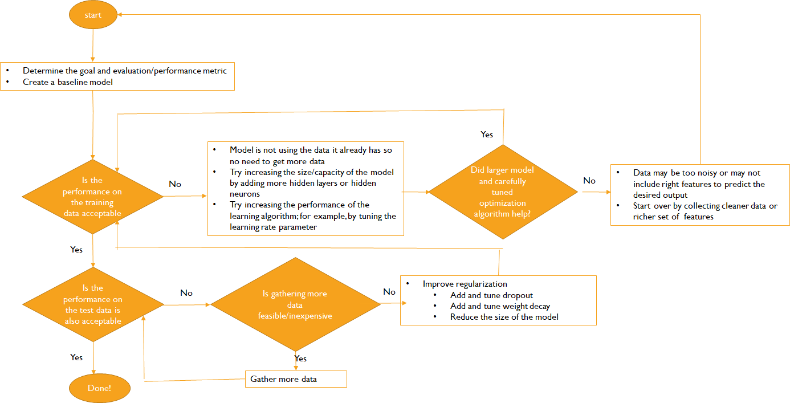
When to get more data?

Slide 13
Determining the bottleneck and making incremental changes
When to get more data?
Selecting Hyperparameters
Manual
Automatic
Debugging the model

Slide 14
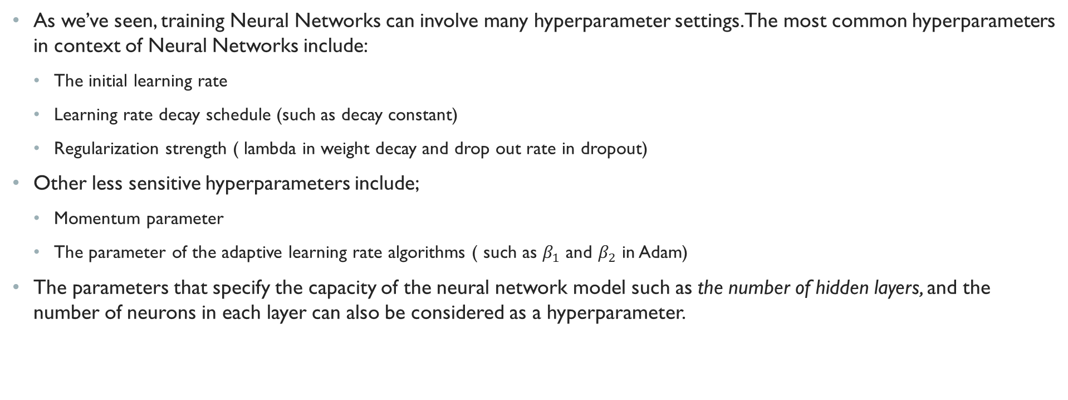
Selecting hyperparameters
As we’ve seen, training Neural Networks can involve many hyperparameter settings. The most common hyperparameters in context of Neural Networks include:
The initial learning rate
Learning rate decay schedule (such as decay constant)
Regularization strength ( lambda in weight decay and drop out rate in dropout)
Other less sensitive hyperparameters include;
Momentum parameter
The parameter of the adaptive learning rate algorithms ( such as $β_{1}$ and $β_{2}$ in Adam)
The parameters that specify the capacity of the neural network model such as the number of hidden layers, and the number of neurons in each layer can also be considered as a hyperparameter.

Slide 15
K-fold vs one-fold validation
Recall that in lecture 1. preliminary we mentioned that when the input data is small, it is preferable to do k-fold cross validation as opposed to a hold-out validation and choose the hyper-parameters which yield the lowest cross validation error.
It is a common practice in deep learning to prefer a single validation set of respectable size instead of k-fold cross validation for two reasons:
Training deep neural networks is a very expensive operation, and put it simply, training k of them per every combination of hyper-parameters is impractical
Most of the time, we are hopefully applying deep learning in situations where we have abundance of data so we can afford to set a side a respectable size data for validation and testing without affecting the training performance.

Slide 16
Approaches to hyperparameter tuning
There are two basic approaches to choosing the hyperparameters
Choosing them manually which requires understanding of each hyperparameter and how it affects the optimization and generalization
Choosing them automatically which reduces the need to understand each hyperparameter but is much more costly

Slide 17
Manual hyperparameter tuning
The primary goal of manual hyperparameter search is to adjust the eﬀective capacity of the model to match the complexity of the task
The effective capacity depends on three factors:
The representational capacity of the model
Typically controlled by the number of hidden layers and number of neurons in each hidden layer
The ability of the optimization algorithm to successfully minimize the training loss
The most important hyparameter that controls the behavior of the optimization algorithm is the learning rate.
The degree to which the cost function and training procedure regularize the model ( i.e., reduce the gap between training and test error)
This is mostly controlled by regularization hyperparameters such as the drop out factor or weight decay

Slide 18
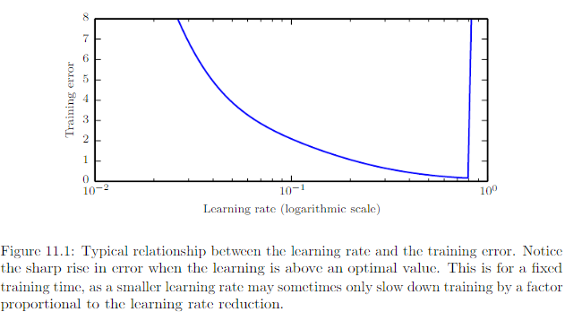
Tuning Learning Rate
Learning rate is probably the most important hyperparameter. If you have time to tune only one hyperparameter, tune the learning rate.
The learning rate typically has a U-shape curve for the training error.
When the learning rate is too large gradient descent can inadvertently increase rather than decrease the training error
When the learning rate is too small, training is not only slower but may become permanently stuck with a high training error
Image from goodfellow etc. al. (deep learning book), chapter 11

Slide 19
Tuning other hyperparamters
Tuning hyperparameters other than the learning rate requires monitoring both the training and test error to see where your model is overfitting or underfitting.
If the training error is high, then you have no choice but to increase the capacity of the model.
If you are not using regularization and you are confident that your optimization algorithm is performing correctly, then you must add more layers or more hidden neurons to increase the capacity of your model
Keep in mind that adding more layers ( and more neurons) increases the computational cost associated with the model
If the test error is high, then you should change regularization hyperparameters (such as weight decay and drop out factor) to reduce effective model capacity.
Neural networks typically perform best when the training error is very low ( and thus capacity is high) and the test error is primarily driven by the gap between training and testing.
Changing regularization hyperparameters allow us to reduce this gap without necessarily increasing training error
Therefore, first focus on reducing the training error then once you are happy with the training error start regularizing your network to reduce overfitting and improve the test error.

Slide 20
Determining the bottleneck and making incremental changes
When to get more data?
Selecting Hyperparameters
Manual
Automatic
Debugging the model

Slide 21
Automatic Hyperparametr tuning
Manual hyperparameter tuning can work very well when the user has a good starting point, such as one determined by others having worked on the same type of application and architecture
For many applications; however, this starting point is not available and automated algorithms can find useful values of hyperparameters.
There are three types of automated hyperparameter search algorithms:
Grid search
Random Search
Model-based hyperparameter optimization

Slide 22
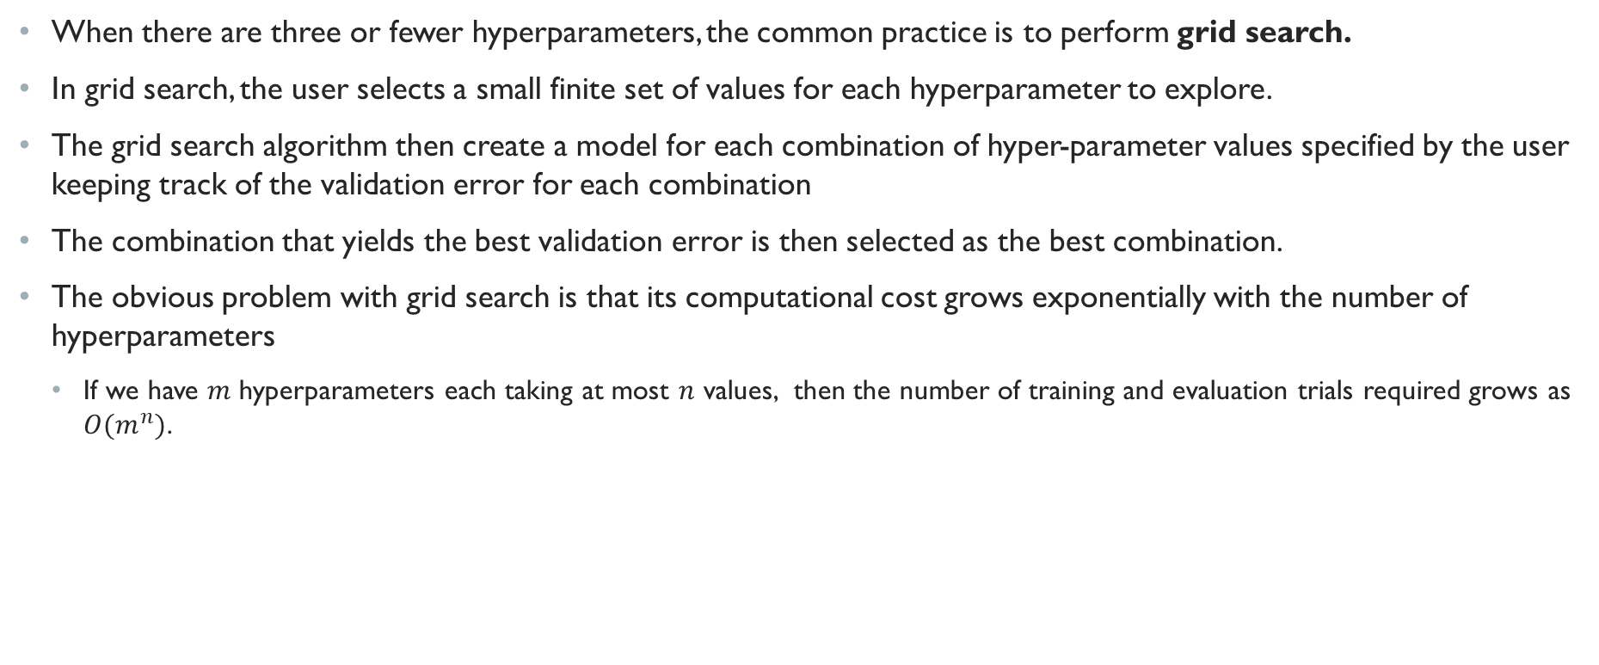
Grid Search
When there are three or fewer hyperparameters, the common practice is to perform grid search.
In grid search, the user selects a small finite set of values for each hyperparameter to explore.
The grid search algorithm then create a model for each combination of hyper-parameter values specified by the user keeping track of the validation error for each combination
The combination that yields the best validation error is then selected as the best combination.
The obvious problem with grid search is that its computational cost grows exponentially with the number of hyperparameters
If we have $m$ hyperparameters each taking at most $n$ values, then the number of training and evaluation trials required grows as $O(m^{n})$.

Slide 23
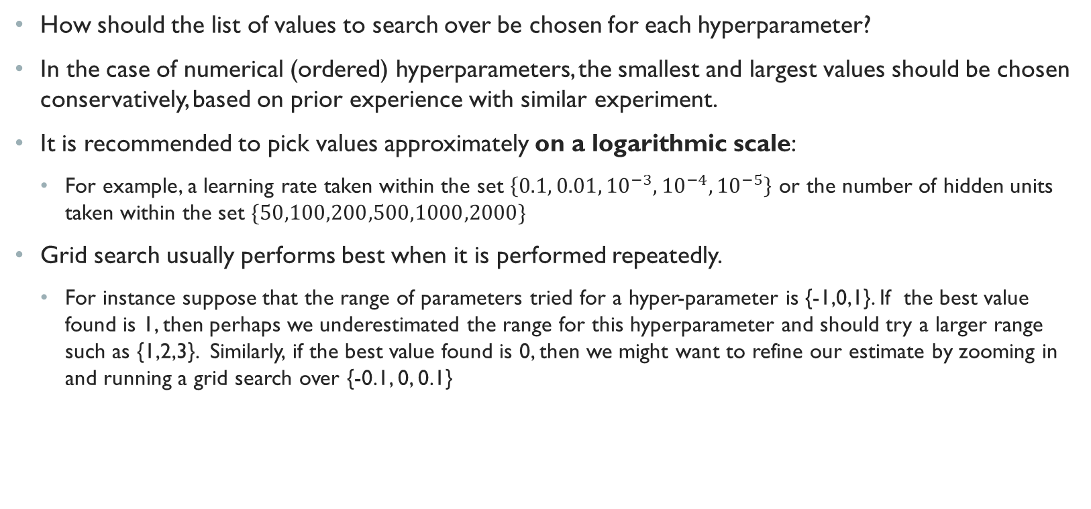
Hyperparameter range
How should the list of values to search over be chosen for each hyperparameter?
In the case of numerical (ordered) hyperparameters, the smallest and largest values should be chosen conservatively, based on prior experience with similar experiment.
It is recommended to pick values approximately on a logarithmic scale:
For example, a learning rate taken within the set $\left\{0.1, 0.01, {10}^{−3},{10}^{−4},{10}^{−5}\right\}$ or the number of hidden units taken within the set $\{50,100,200,500,1000,2000\}$
Grid search usually performs best when it is performed repeatedly.
For instance suppose that the range of parameters tried for a hyper-parameter is {-1,0,1}. If the best value found is 1, then perhaps we underestimated the range for this hyperparameter and should try a larger range such as {1,2,3}. Similarly, if the best value found is 0, then we might want to refine our estimate by zooming in and running a grid search over {-0.1, 0, 0.1}

Slide 24

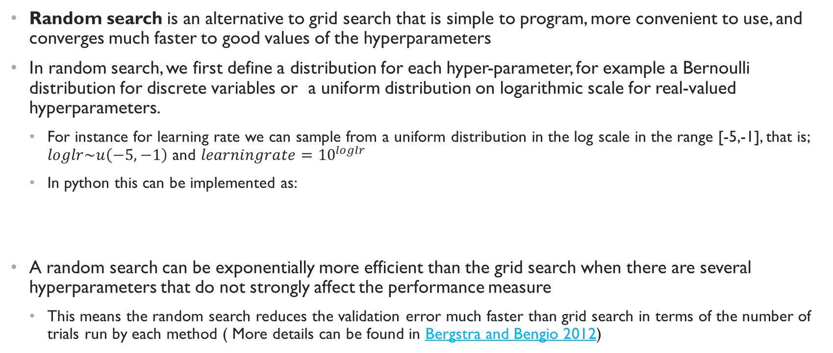
Random Search
Random search is an alternative to grid search that is simple to program, more convenient to use, and converges much faster to good values of the hyperparameters
In random search, we first define a distribution for each hyper-parameter, for example a Bernoulli distribution for discrete variables or a uniform distribution on logarithmic scale for real-valued hyperparameters.
For instance for learning rate we can sample from a uniform distribution in the log scale in the range [-5,-1], that is; $loglr\sim u\left(−5,−1\right)$ and $learningrate={10}^{loglr}$
In python this can be implemented as:
A random search can be exponentially more efficient than the grid search when there are several hyperparameters that do not strongly affect the performance measure
This means the random search reduces the validation error much faster than grid search in terms of the number of trials run by each method ( More details can be found in Bergstra and Bengio 2012)

Slide 25
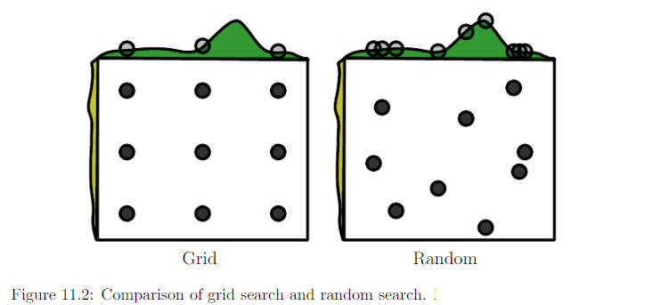
Random Vs Grid Search
To perform grid search, user provides a pre-defined set of values for each hyperparameter
In random search, user samples randomly from a pre-defined distribution
The picture only shows two hyperparameters for illustration purposes but we are typically interested in many more
The validation error is shown along each hyperparameter axis in green
This figure illustrates a typical case where only some hyperparameters have a significant influence on the validation error
In this illustration the validation error along the hyperparameters on the vertical axis does not change much. In contrast the validation error along the hyperparameter on the horizontal axis has much more variation signaling the significance of this hyperparameter.
The grid search wastes an amount of computation that is exponential in the number of non-influential hyperparameters. ( In this figure, it trains and evaluates 9 models while only trying three different values for the influential hyperparameter)
In contrast, random search tests a unique value for every influential hyperparameter on nearly every trial. (in this figure, it trains and evaluates 9 models with 9 different values for the influential hyperparameter)
Image from goodfellow etc. al. (deep learning book), chapter 11

Slide 26
Successive Halving: Improvement to random search
Successive halving (Jamieson and Talwalker, 2015) is an improvement to random search problem which strives to stop bad configurations early in the hyparameter search process.
Successive halving is based on the assumption that the good hyperparameter configurations tend to score higher relatively to the worst one after a small number of iterations.
So if we get rid of what seems to be bad configurations early on, we can spend most of our time exploring more promising configuration
Suppose you have a fixed total budget (amount of resources) that you can dedicate to hyperparamter search. For instance, you can run each hyperparameter configurations a certain number of epoch.
Randomly sample a set of hyperparameter configuration as you do in grid search.
Uniformly allocate a budget to a set of candidate hyperparameter configurations in a given rung.
Evaluate the validation loss of all candidate configurations.
Promote the top half of candidate configurations to the next rung.
Double the budget per configuration for the next rung and repeat until one configurations remains.
The algorithm can be generalized to allow for a variable rate of elimination η so that only 1/η of configurations are promoted to the next rung.
higher η indicates a more aggressive rate of elimination where all but the top 1/η of configurations are eliminated.

Slide 27
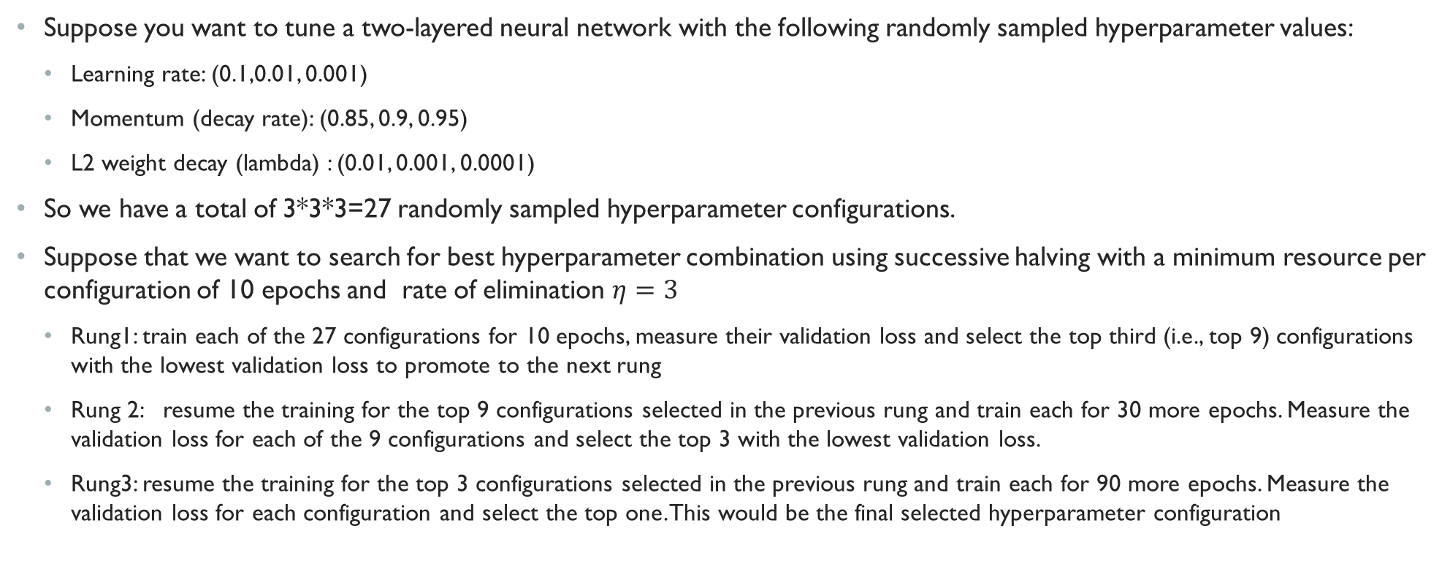
Successive Halving Example
Suppose you want to tune a two-layered neural network with the following randomly sampled hyperparameter values:
Learning rate: (0.1,0.01, 0.001)
Momentum (decay rate): (0.85, 0.9, 0.95)
L2 weight decay (lambda) : (0.01, 0.001, 0.0001)
So we have a total of 3*3*3=27 randomly sampled hyperparameter configurations.
Suppose that we want to search for best hyperparameter combination using successive halving with a minimum resource per configuration of 10 epochs and rate of elimination $η=3$
Rung1: train each of the 27 configurations for 10 epochs, measure their validation loss and select the top third (i.e., top 9) configurations with the lowest validation loss to promote to the next rung
Rung 2: resume the training for the top 9 configurations selected in the previous rung and train each for 30 more epochs. Measure the validation loss for each of the 9 configurations and select the top 3 with the lowest validation loss.
Rung3: resume the training for the top 3 configurations selected in the previous rung and train each for 90 more epochs. Measure the validation loss for each configuration and select the top one. This would be the final selected hyperparameter configuration

Slide 28
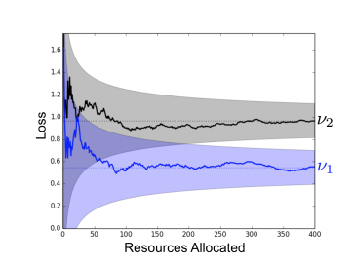
Hyperband: Improvement to successive halving
One issue with successive halving for hyperparameter search is that it uniformly distributes resources among all candidate configurations in each rung.
This could be problematic because some good configurations may have a high validation loss initially and hence be omitted in the early rungs if they are not given enough resources.
For instance, the figure on the right shows two different hyperparameter configurations (v1 and v2). The horizontal axis shows the resource allocated to each configuration ( for instance, the number of epochs) and the vertical axis shows the validation loss. As you can see, while configuration v1 initially performs worse than configuration v2, it eventually leads into a lower validation loss if allocated enough resources. A successive halving might prune v1 early on.
Of course we don’t know that v1 is going to perform better than v2 beforehand.
An extension to successive halving, called hyperband (), tries to address this issue by randomly (instead of equally) distribute resources among the remaining configuration in each rung of successive halving.
The technical details of hyperband is out of the scope of this class but if you are interested, you can refer to (Lisha, et. al. 2018)

Slide 29
Determining the bottleneck and making incremental changes
When to get more data?
Selecting Hyperparameters
Manual
Automatic
Debugging the model

Slide 30
Model-based hyperparameter optimization
There is a whole area of research devoted to coming up with algorithms that try to more efficiently navigate the space of hyperparameters instead of just navigate it randomly as in the random search
Most model-based algorithms for hyperparameter search use a Bayesian regression model to estimate both the expected value of the validation error for each hyperparameter and the uncertainty around this expectation
The details of Bayesian regression is beyond the scope of this class but if you are interested you can find more details Shahriari et. al (Taking human out of the loop: A review of Bayesian Optimization)
The core idea of these algorithms is to balance the exploration vs exploitation:
Exploration: proposing hyperparameters for that there is high uncertainty, which may lead to large improvement but may also perform poorly.
Exploitation: proposing hyperparameters that the model is confident will perform well—usually the ones that are similar to the ones the search algorithm has seen so far
Bayesian hyperparameter optimization sometimes performs comparably to human experts, sometimes better, but fails catastrophically on other problems
So we cannot say for sure that Bayesian hyperparameter optimization is superior to random search for all problems.
In practical setting it is still relatively difficult to beat random search ( or its improvements) if the range of hyperparameters are carefully chosen.

Slide 31
Some Debugging Suggestions
Machine learning systems are difficult to debug for various reasons.
In most cases, we do not know a priori what the intended behavior of the algorithm is.
If we train a neural network on a new classiﬁcation task and it achieves 5 percent test error, we have no straightforward way of knowing if this is the expected behavior or suboptimal behavior
Here are few suggestions which may help debug your neural network model:
Visualize the model in action
It is tempting to only look at the quantitative performance measures such as accuracy
But it is also recommended to directly observing the machine learning model performing its task to see whether the performance measure is reasonable. For instance, if the model is supposed to do object detection, view some images with the detection proposed by the model, when doing text classification, view some text together with their proposed label to see if it seems reasonable.

Slide 32
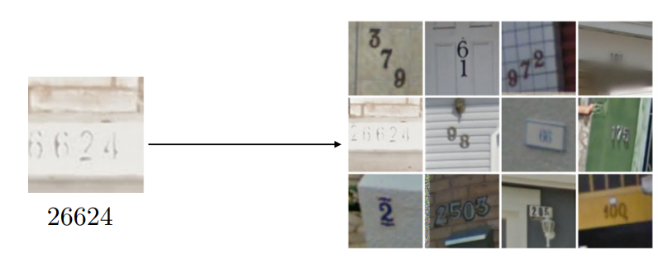
Debugging Suggestions (Cont.)
Visualize the worst mistake
For instance, when you do classification, the output layer with softmax activation gives you the probability of each label. When comparing this with correct labels, it is often helpful to view the examples that the model incorrectly classified with a very high confidence/probability. Can you find any systematic error on those examples?
An example where this debugging strategy proved very helpful is mentioned in the Deep Learning Book ( Goodfellow et.al) where a deep convolutional neural network was used for Google street view transcription ( to transcribe the house numbers from street view photographs)
To debug the model, the authors visualized the incorrect training set transcriptions for which the model gave the highest probability.
These proved to mostly consist of examples where the input image had been cropped too tightly, with some of the digits of the address being removed by the cropping operation
By widening the crop regions and retraining the model, they were able to increase the performance of the model by 10%.
Monitor training and validation error
Address underfitting/overfitting as explained previously

Slide 33
End of lecture

